Slide 1


Antenna Summit
<number>

Slide 2
Session 3 – Components
Chapter 4.1 to 4.5.6
+ Other Material

Slide 3

Instructor:
Phil Brunner – AE7OH (was K9DTD, W6GOL)
ARRL HANDBOOK for Radio Communications
– (Reference for detailed information)
Q & A via Chat or at the end of each hour
Email questions to: phil.brunner@gmail.com
Viewgraphs are at http://HamRadioEdu.com

Slide 4
Chapter 4 – Components
The World of electronics is changing rapidly
    Landlines replaced by Cell Phone, Zoom, Skype
    Vacuum Tubes Disappearing – (Light Bulbs, CRTs, Radio Tubes)
Computers and DSPs are replacing individual components and units.
Software Defined Radios are available today.
We will concentrate on characteristics and skip the details!

Slide 5
Components Characteristics
Practical Resistors, Capacitors and Inductors
Transformers
Semiconductors
Amplifiers
Vacuum Tubes
Circuit Simulation and AnalysisTools
Antennas and Tuners
Software Defined Radios and Units

Slide 6
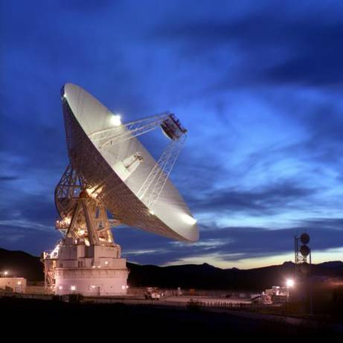
Starting Big - 112-foot
112-foot Goldstone
Deep Space
Antenna
with Subreflector

Slide 7
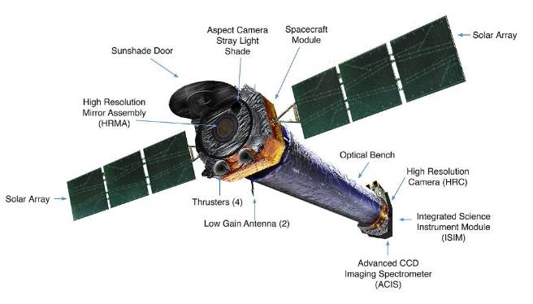
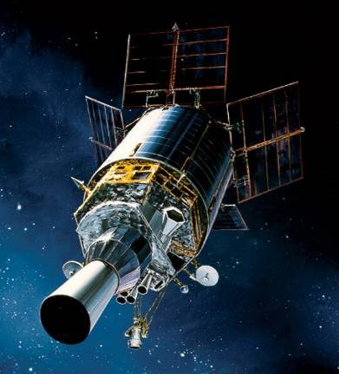
Satellite Antennas
Defense Support Program Chandra Xray Telescope
https://en.wikipedia.org/wiki/Defense_Support_Program https://en.wikipedia.org/wiki/Chandra_X-ray_Observatory

Slide 8
Resistors
Wire size suitable for max current
Resistance usually increases with temperature
Component Resistors
      Carbon, Metal-oxide
      Wirewound- low-frequency due to inductance
      Metal-film, Carbon-film – deposit on insulating substrate
Power rating and temperature stability are considerations
Tolerance often unimportant – 20%, 10%, 5%, 1%
Potentiometers – variable resistors

Slide 9
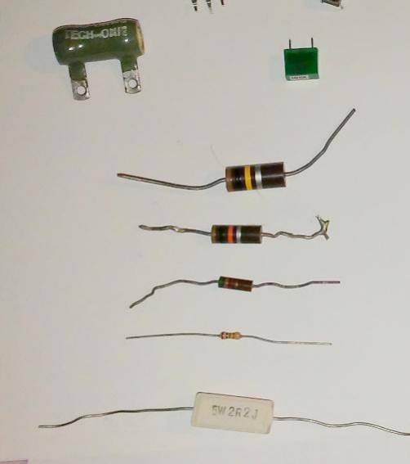
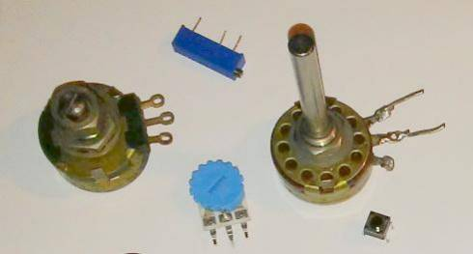
Resistors

Slide 10
Capacitors
Ideally blocks DC, no leakage, no energy loss
Tolerance and temperature coefficient
Voltage rating and breakdown
Frequency, resistance, leakage, inductance considerations
Ceramic, plastic film, mica, electrolytic, air-variable, vacuum
Electrolytics are high capacity and polarized - low frequency filtering

Slide 11
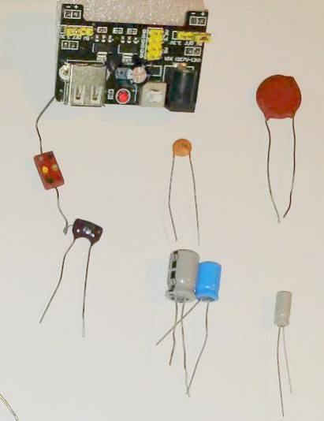
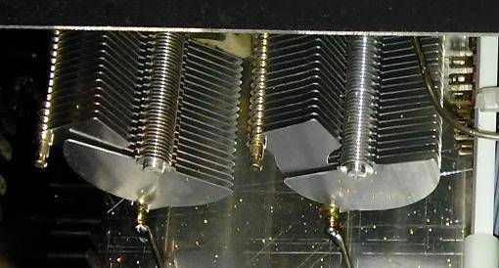
Capacitors

Slide 12
Inductors
Air-core or iron-core
Encapsulated (looks like resistor)
Slug tuned (variable)
  magnetic or non-magnetic core inside coiled inductor
  Adjust with screw-driver

Slide 13
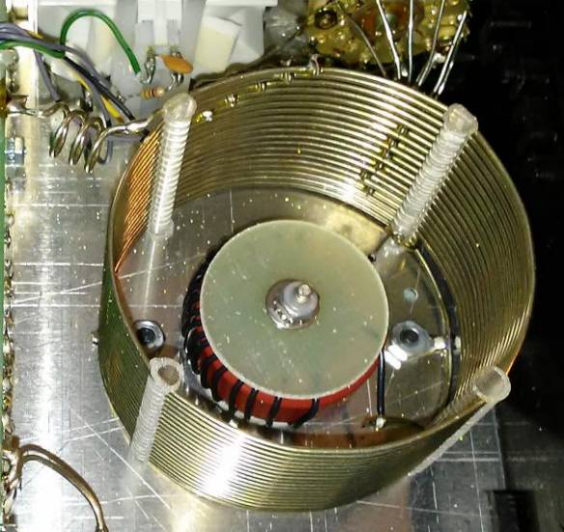
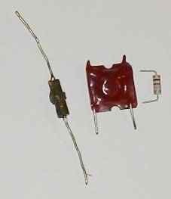
Inductors

Slide 14
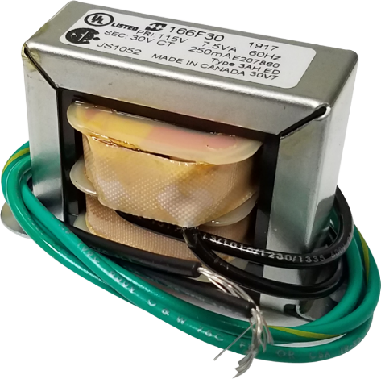
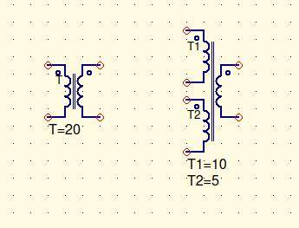
Transformers

Slide 15
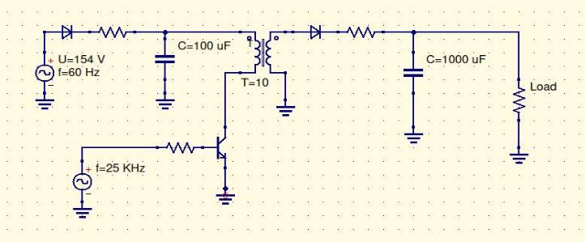
Switching Power Supply (Conceptual)
- Use high frequency to minimize transformer size/weight
- Needs careful design/shielding to avoid HF interference

Slide 16
Semiconductors
Diodes – Point Contact, Pin, Schottky, Varactor, Zener
  Current, PIV, Speed, Reverse Current
Transistors – BJT, JFET, MOSFET
  Gain, Operating Regions and Parameters
Optical – Photo, LED, Laser, Optoisolators
Fiber Optics

Slide 17
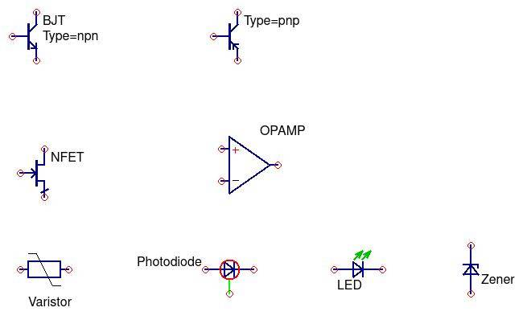
Some Semiconductor Symbols

Slide 18
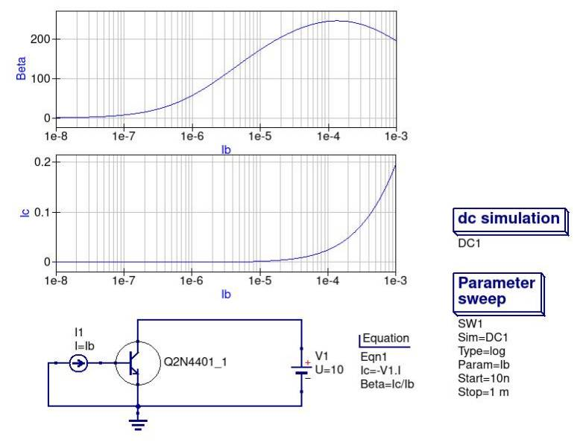
NPN Amplifier

Slide 19
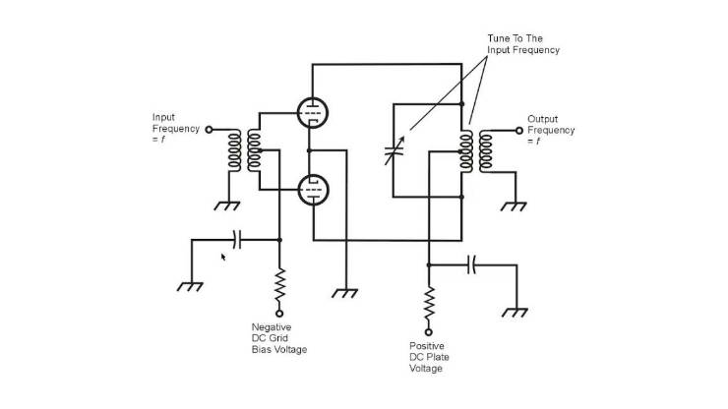
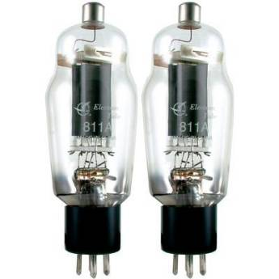
811A Vacuum Tube Push-Pull Final

Slide 20
TOOLS
Arduino UNO + Breadboard
QUES – Quite Universal Circuit Simulator (Free)
  https://sourceforge.net/projects/qucs/files/latest/download
Circuit Calculations with Complex Numbers and Spreadsheets (Excel or LibreOffice CALC)
  Free LibreOffice Download: https://www.libreoffice.org/
Software Modems
Software Defined Radios

Slide 21
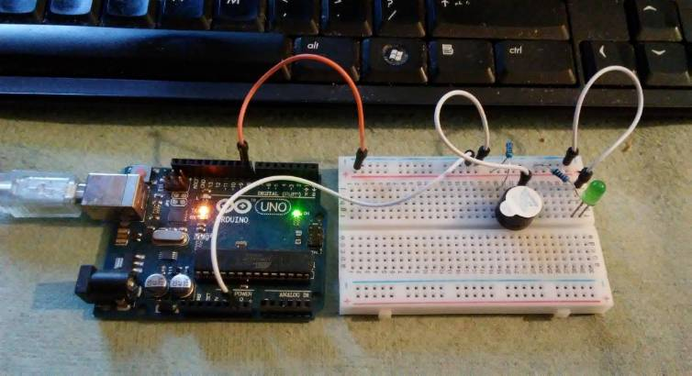
Arduino and Breadboard
CQ CQ DE AE7OH K

Slide 22
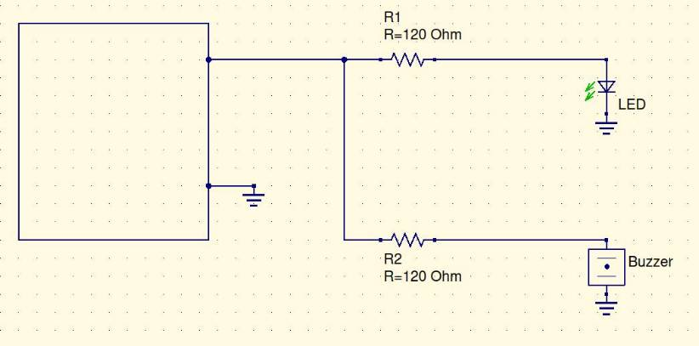
Arduino+Breadboard Schematic
Arduino

Slide 23
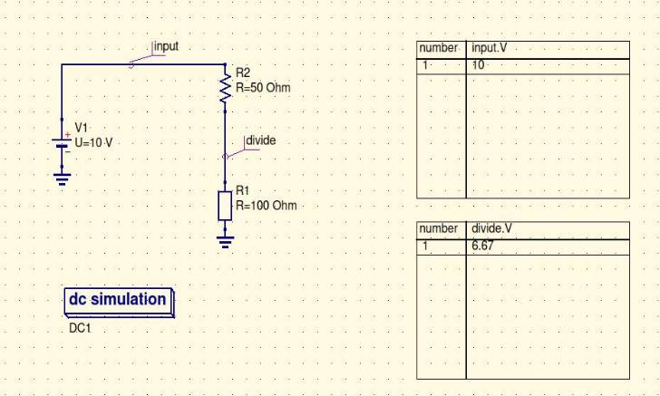
QuiteUniversalCircuitSimulator https://sourceforge.net/projects/qucs/files/latest/download
Manual: http://qucs.sourceforge.net/docs/tutorial/getstarted.pdf

Slide 24
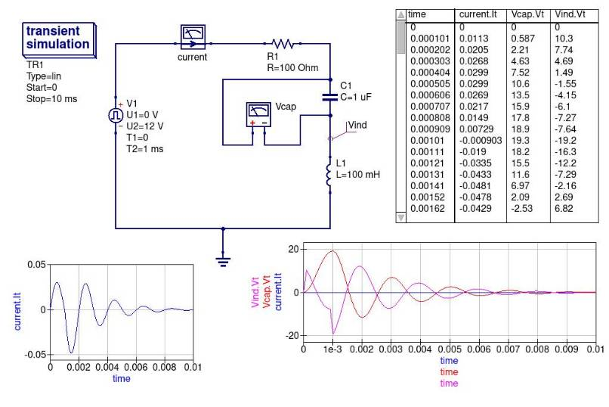
RLC
Transient
Simulation

Slide 25
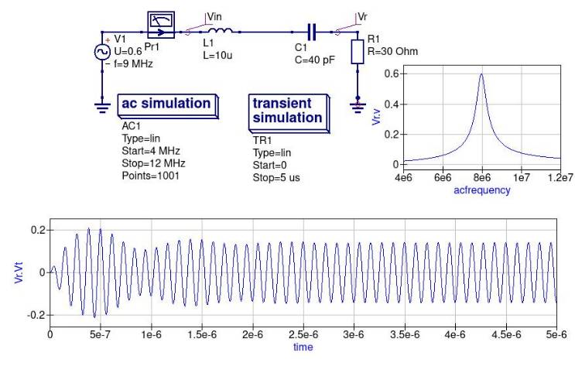
RLC
Frequency
And
Transient
Simulations

Slide 26
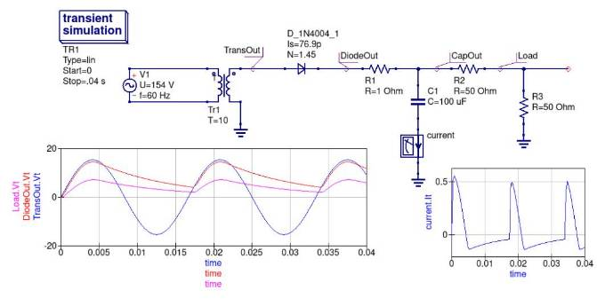
Simple Power Supply

Slide 27
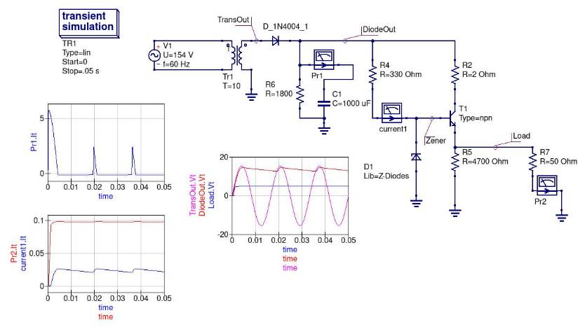
Regulated Power Supply

Slide 28
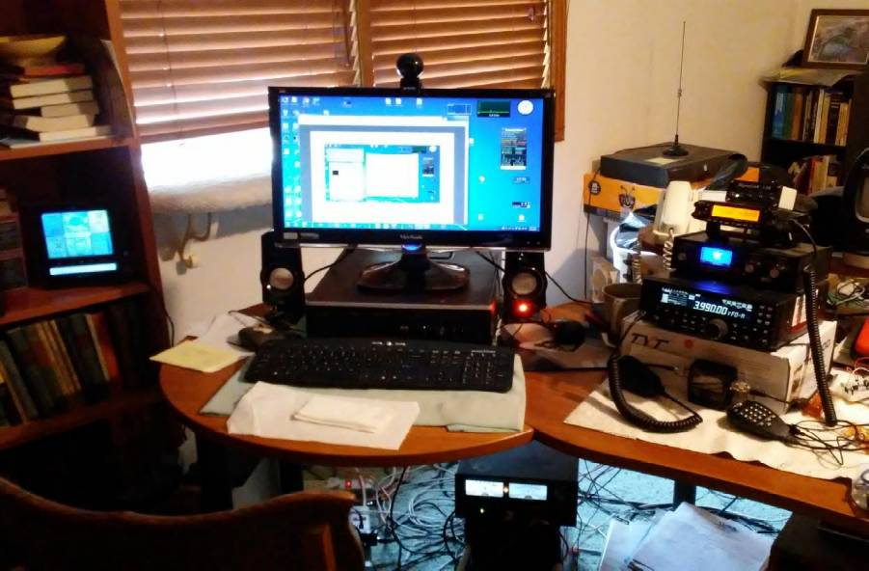

Slide 29
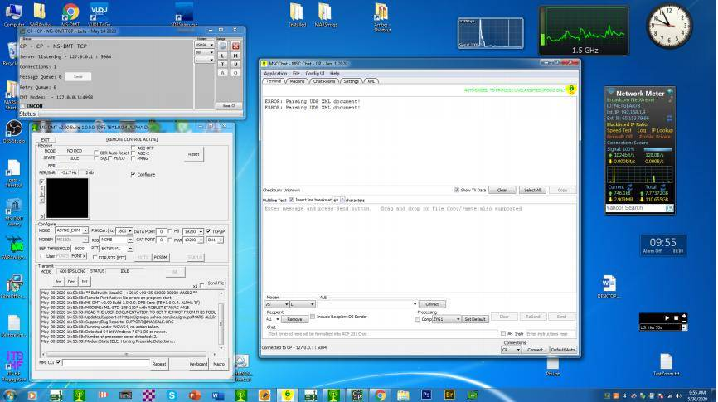
MODEM IS ENTIRELY SOFTWARE
Pictures

Slide 30
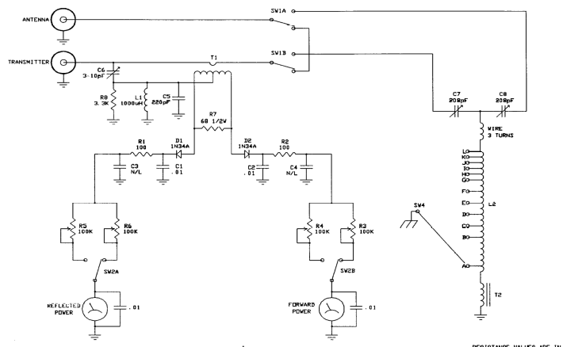
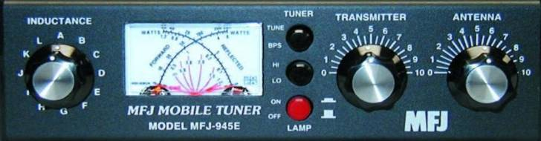

Slide 31
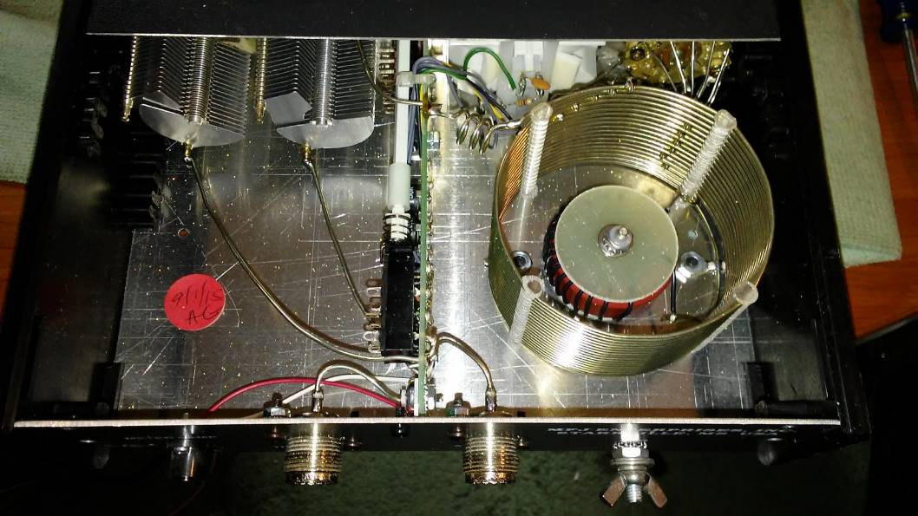

Slide 32
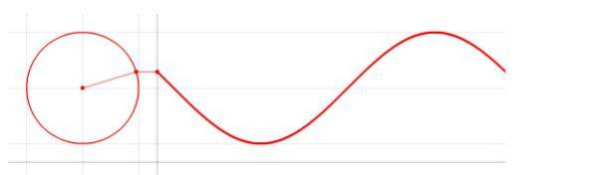
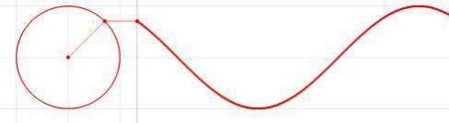
Alternating Current Sinusoids
imaginary
Radius rotates at f cycles per second to create sinusoid
real

Slide 33
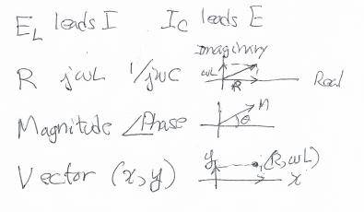
AC Representation Choice
for Calculations
Eli the Ice man
Complex Numbers
(easy calcs)
Polar form
Vectors

Slide 34
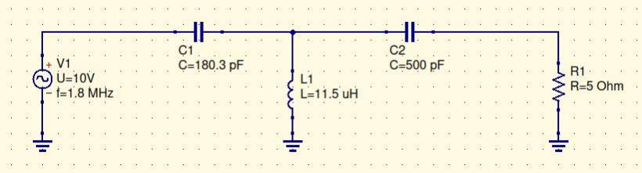
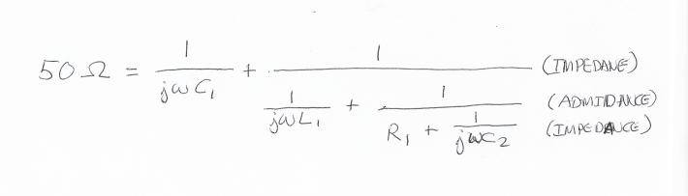
Calculate Tuned Antenna Impedance

Slide 35
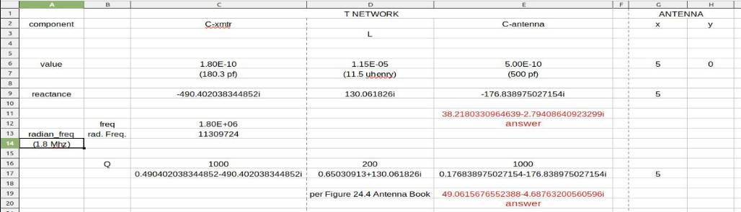
Tuner Calc Spreadsheet
(See Figure 24.4 in Antenna Book)

Slide 36
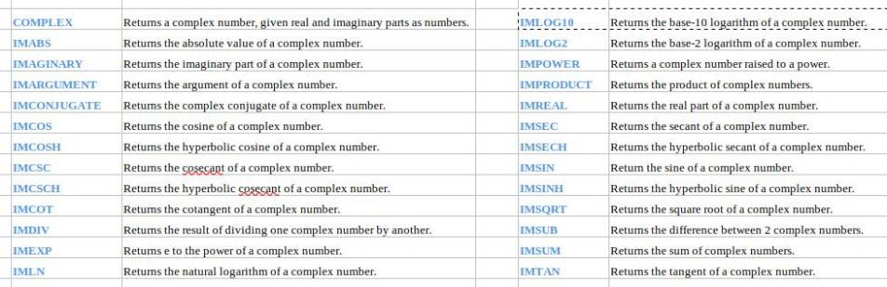
Excel or CALC Complex Functions

Slide 37
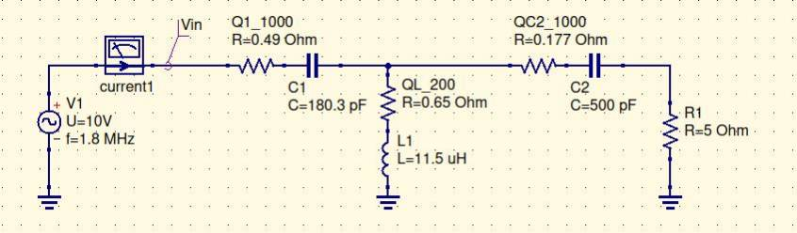
Tuner Adjustments
Tuner adjusted 5-Ohm Antenna to 38 ohms
Ant. Book assumed Q-values for components
Added Q-Resistors yield 50 ohms

Slide 38
Tuner Reactance Tweaks
Minor phase error in answer can be removed by changing C1 to zero the reactance error
C2 can be adjusted to compensate for a reactive component in the Antenna:
    Decrease C2 to compensate for inductive antenna
    Increase C2 to compensate for capacitive antenna
Antenna design would probably try to make antenna nearer to the ideal 50-ohm, 0-reactance impedance at the desired frequency(s)
Stay tuned!

Slide 39
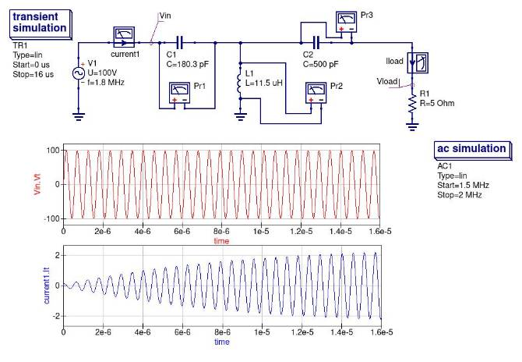
Match1

Slide 40
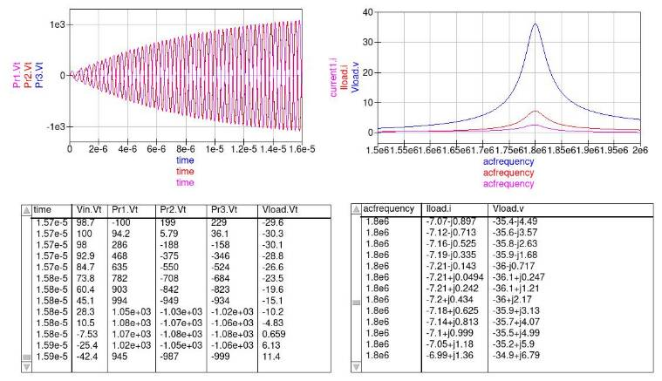
Match2
Input voltage: 100V
But peak voltages across tuner elements are 1000V

Slide 41
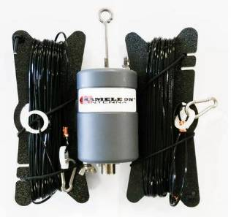
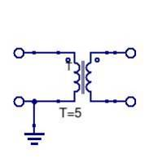
High RF Tuner Voltages
High Voltage in tuner elements
  100 volts peak source
  1000 volts peak across components
Arcing and RF burns potential
Solutions include better antenna design
  e.g., a Balun can help match
Example: 5:1 transformer
Matches 50 ohm coax
To 300 ohm antenna
50
300

Slide 42
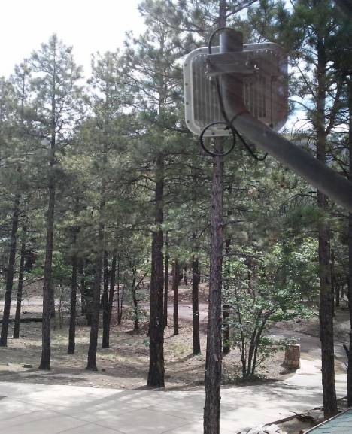
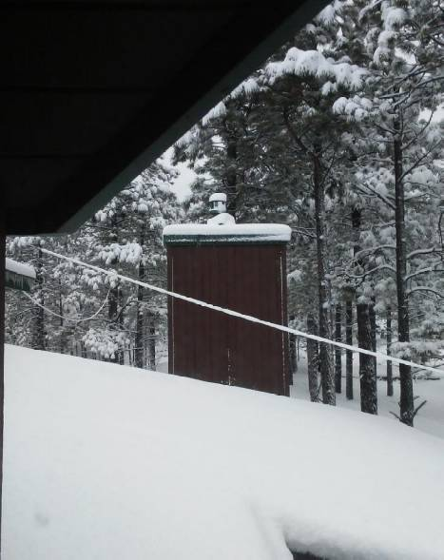
Internet Antenna
CHA TD LITE HF Antenna

Slide 43
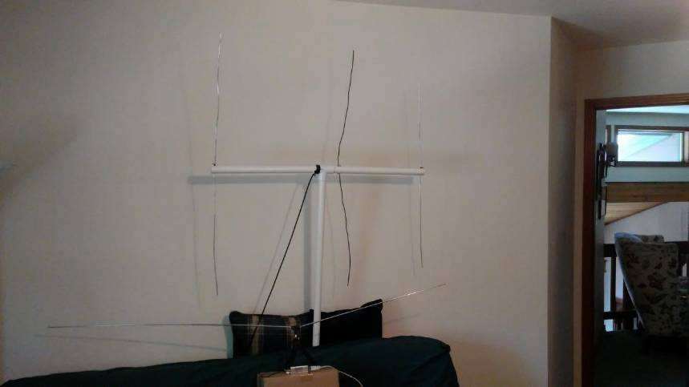
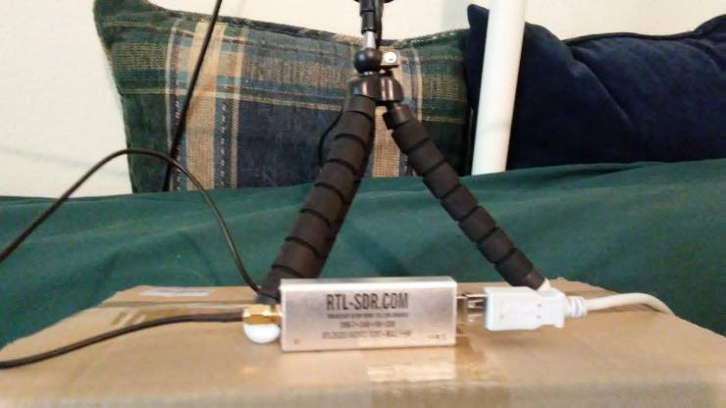

Slide 44
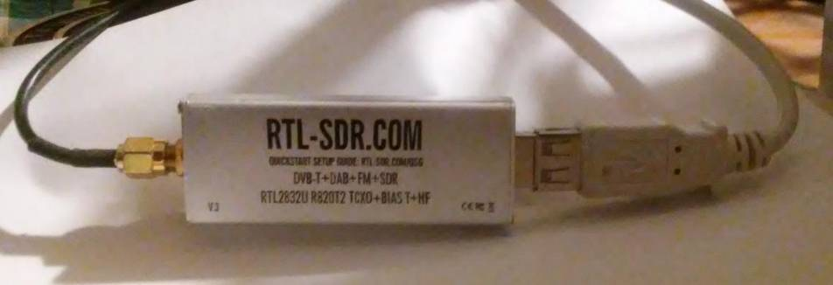
RTL-SDR Software Defined Radio

Slide 45
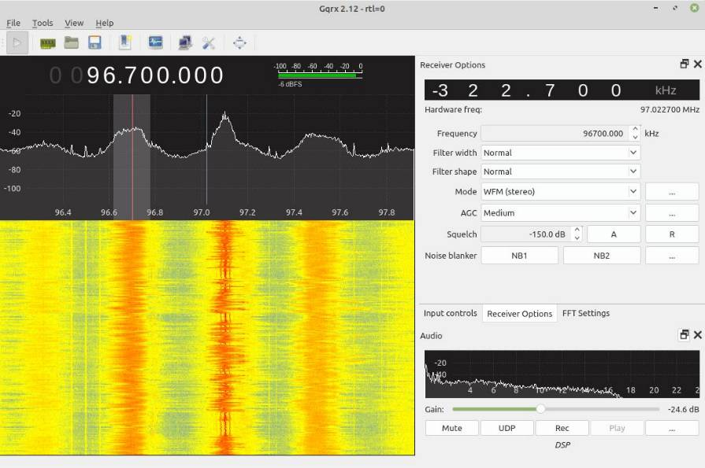
FM
Radio
Station
GQRX
(Linux)
or
SDR-Sharp

Slide 46
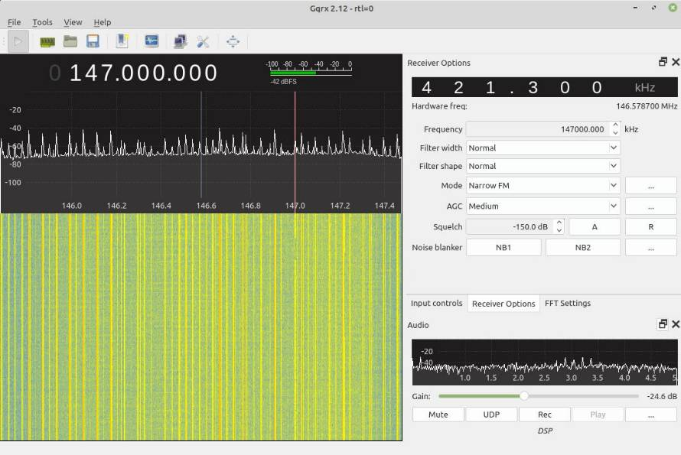
SDR
VHF
Station

Slide 47
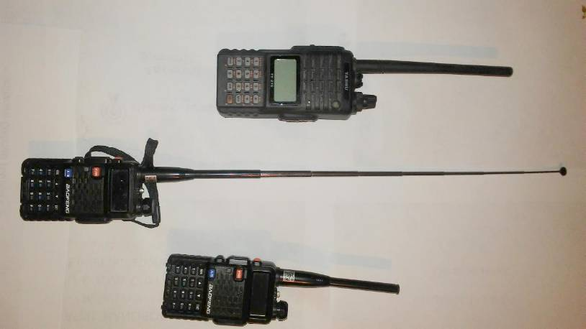
Handhelds

Slide 48
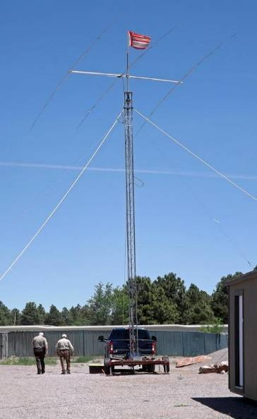
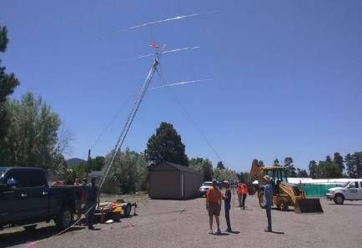

20 Meter Antenna

