Slide 1


Antenna Summit
<number>

Slide 2
Session 3 – Components
Chapter 4.1 to 4.5.6
+ Other Material

Slide 3

Instructor:
Phil Brunner – AE7OH (was K9DTD, W6GOL)
ARRL HANDBOOK for Radio Communications
      – (Reference for detailed information)
Q & A via Chat or at the end of each hour
Email questions to: phil.brunner@gmail.com
Viewgraphs are at HamRadioEdu.com

Slide 4
Chapter 4 – Components
The World of electronics is changing rapidly
    Landlines replaced by Cell Phone, Zoom, Skype
    Vacuum Tubes Disappearing – (Light Bulbs, CRTs, Radio Tubes)
Computers and DSPs are replacing individual components and units (e.g., Modems)
We will concentrate on characteristics and skip the details!

Slide 5
Components Characteristics
Practical Resistors, Capacitors and Inductors
Transformers
Semiconductors
Circuit Simulation and AnalysisTools
Examples

Slide 6
Resistors
Wire size suitable for max current
Resistance usually increases with temperature
Component Resistors
      Carbon, Metal-oxide
      Wirewound- low-frequency due to inductance
      Metal-film, Carbon-film – deposit on insulating substrate
Power rating and temperature stability are considerations
Tolerance often unimportant – 20%, 10%, 5%, 1%
Potentiometers – variable resistors

Slide 7
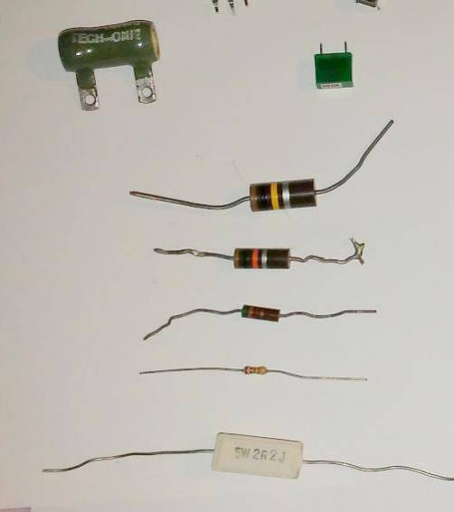
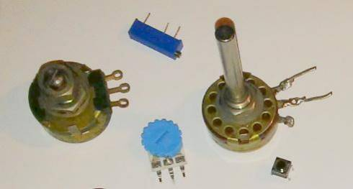
Resistors

Slide 8
Capacitors
Ideally blocks DC, no leakage, no energy loss
Tolerance and temperature coefficient
Voltage rating and breakdown
Frequency, resistance, leakage, inductance considerations
Ceramic, plastic film, mica, electrolytic, air-variable, vacuum
Electrolytics are high capacity and polarized - low frequency filtering

Slide 9
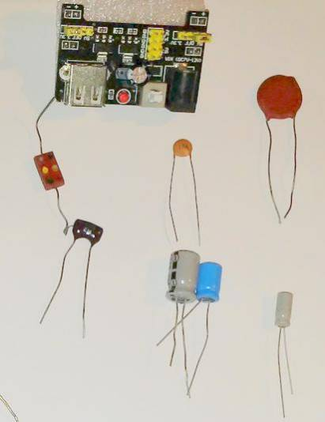
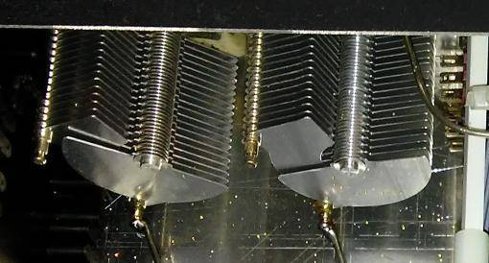
Capacitors

Slide 10
Inductors
Air-core or iron-core
Encapsulated (looks like resistor)
Slug tuned (variable)
  magnetic or non-magnetic core inside coiled inductor
  Adjust with screw-driver

Slide 11
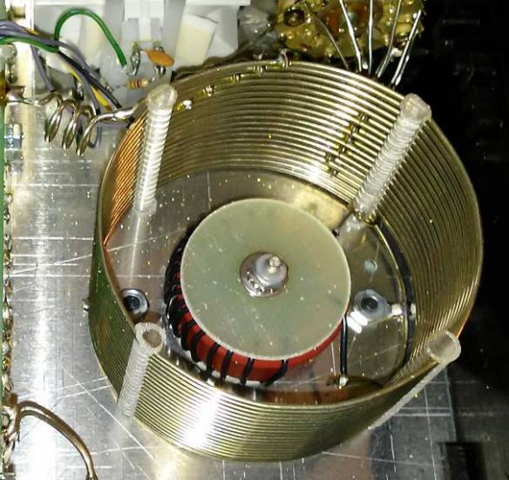
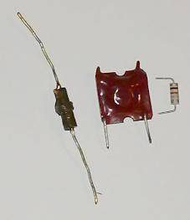
Inductors

Slide 12
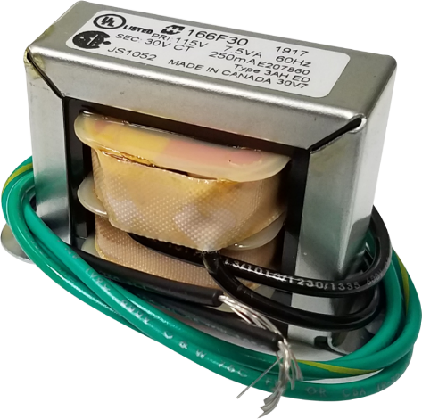
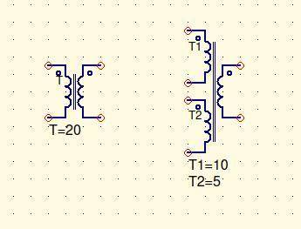
Transformers

Slide 13
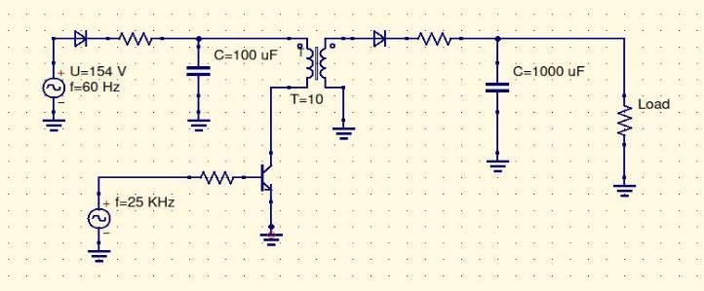
Switching Power Supply (Conceptual)
- Use high frequency to minimize transformer size/weight
- Needs careful design/shielding to avoid HF interference

Slide 14
Semiconductors
Diodes – Point Contact, Pin, Schottky, Varactor, Zener
  Current, PIV, Speed, Reverse Current
Transistors – BJT, JFET, MOSFET
  Gain, Operating Regions and Parameters
Optical – Photo, LED, Laser, Optoisolators

Slide 15
TOOLS
Arduino UNO + Breadboard
QUES – Quite Universal Circuit Simulator (Free)
      https://sourceforge.net/projects/qucs/files/latest/download
Circuit Calculations with Complex Numbers and Spreadsheets (Excel or LibreOffice CALC)
      Free LibreOffice Download: https://www.libreoffice.org/

Slide 16
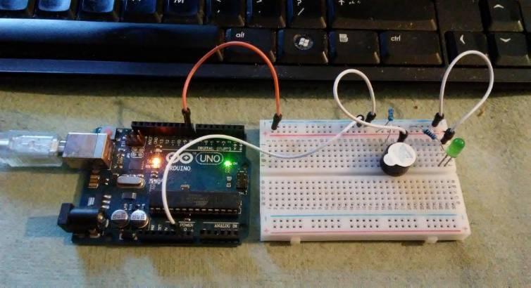
Arduino and Breadboard
CQ CQ DE AE7OH K

Slide 17
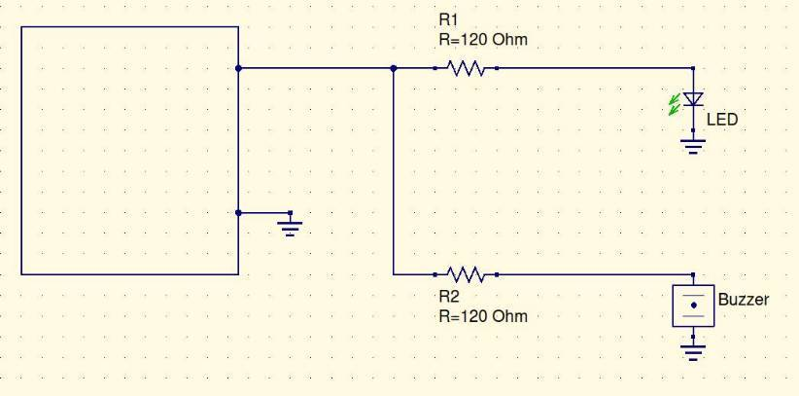
Arduino+Breadboard Schematic
Arduino

Slide 18
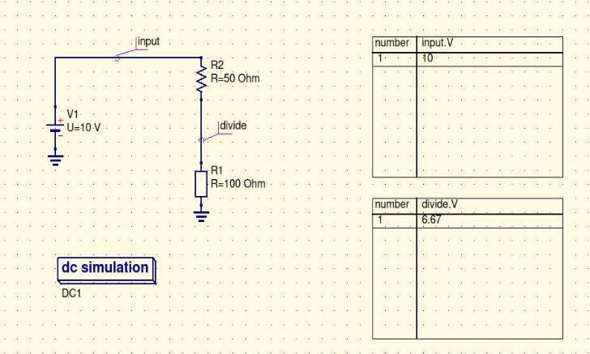
QuiteUniversalCircuitSimulator https://sourceforge.net/projects/qucs/files/latest/download
Manual: http://qucs.sourceforge.net/docs/tutorial/getstarted.pdf

Slide 19
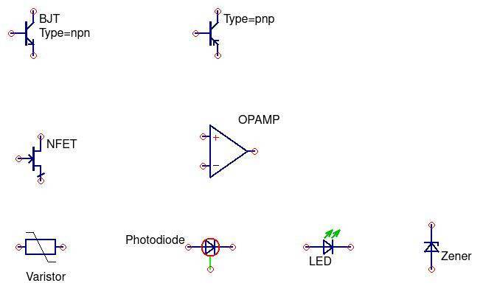
Some Semiconductor Symbols

Slide 20
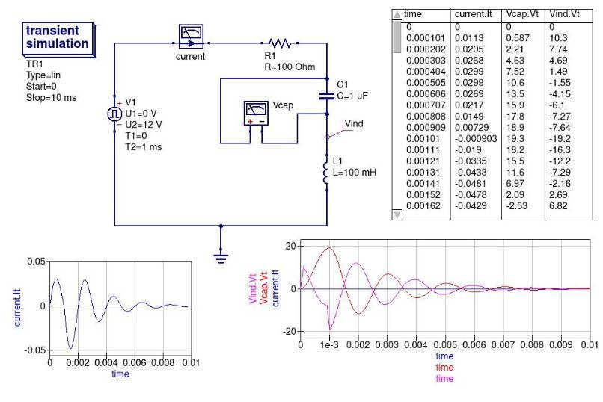
RLC
Transient
Simulation

Slide 21
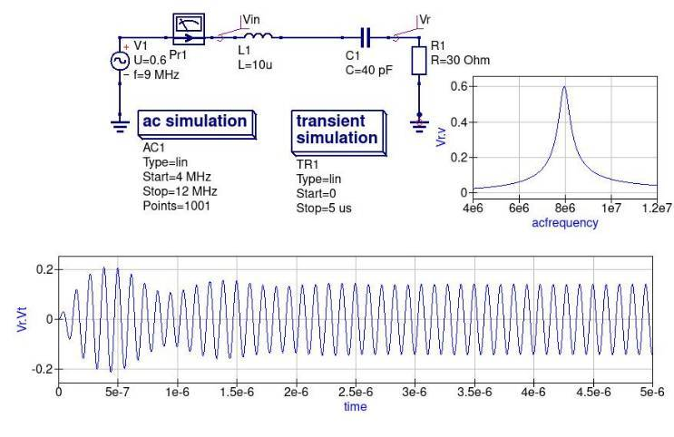
RLC
Frequency
And
Transient
Simulations

Slide 22
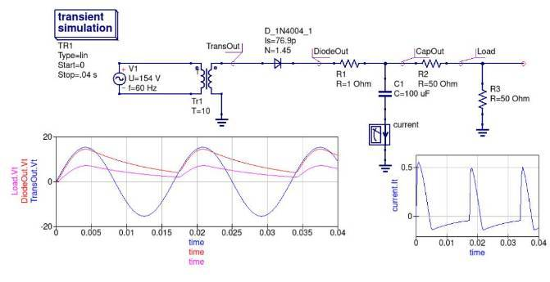
Simple Power Supply

Slide 23
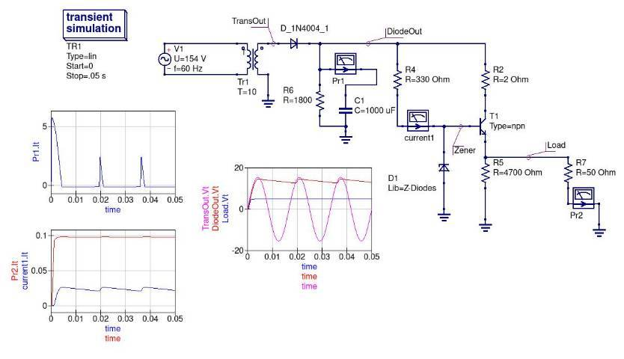
Regulated Power Supply

Slide 24
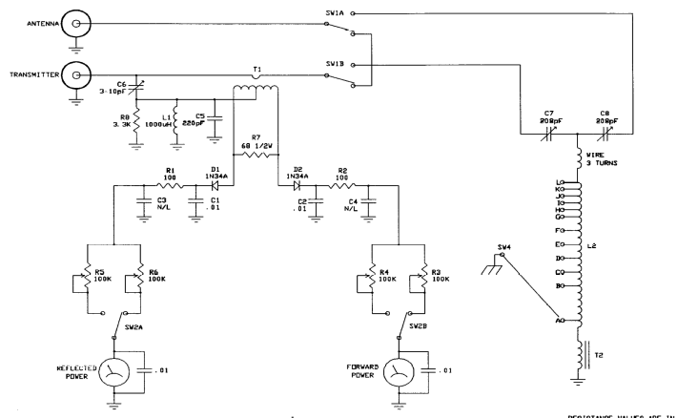
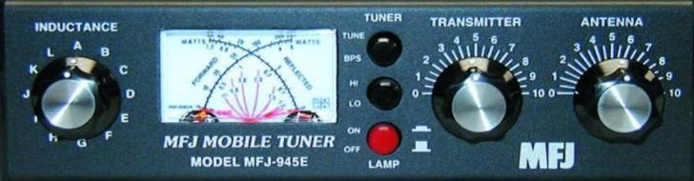

Slide 25
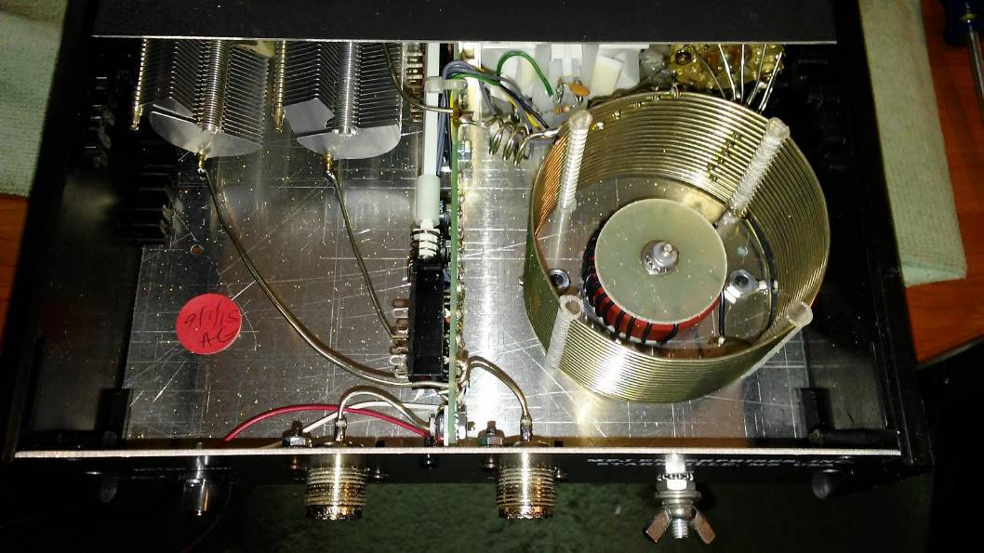

Slide 26
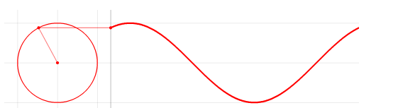
Alternating Current Sine Waves
Radial rotates at f cycles per second to create a sine wave
Imaginary axis
( j or i )
Real axis

Slide 27
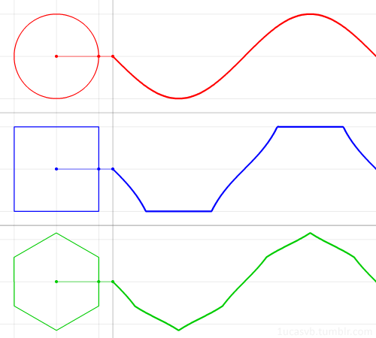
$\frac{1}{jω}$

Slide 28
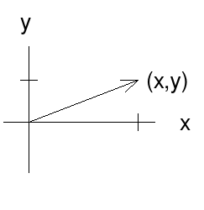
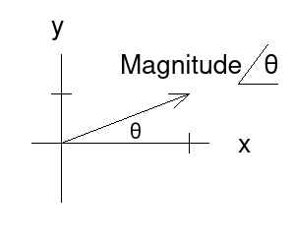
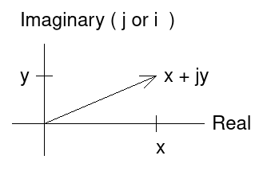
AC Representations
Complex Numbers
(easy calculations)
Vectors
Polar Form

Slide 29
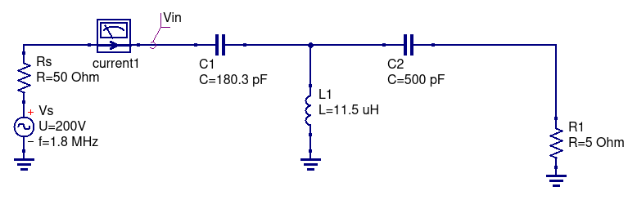
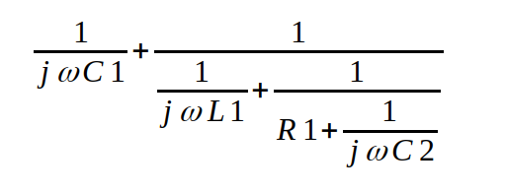
Calculate Impedance Match

Slide 30
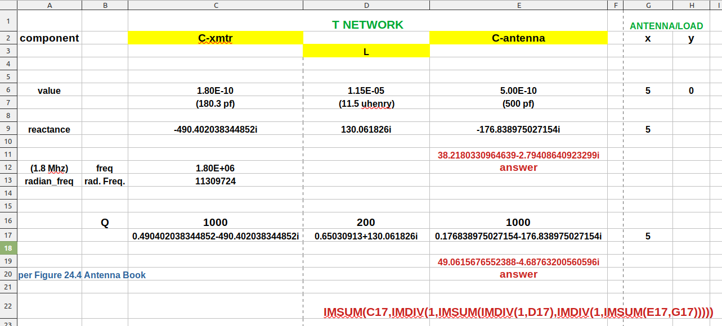
Impedance Match Calc Spreadsheet
(See Figure 24.4 in Antenna Book)

Slide 31
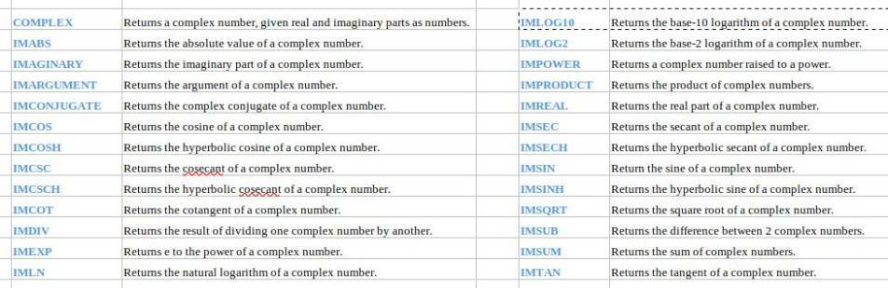
Excel or CALC Complex Functions

Slide 32
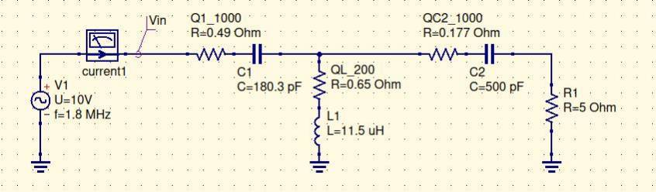
Adjustments for Component Q
Match adjusted 5-Ohm Antenna to 38 ohms
Ant. Book assumed Q-values for components
Added Q-Resistors yield 50 ohms

Slide 33
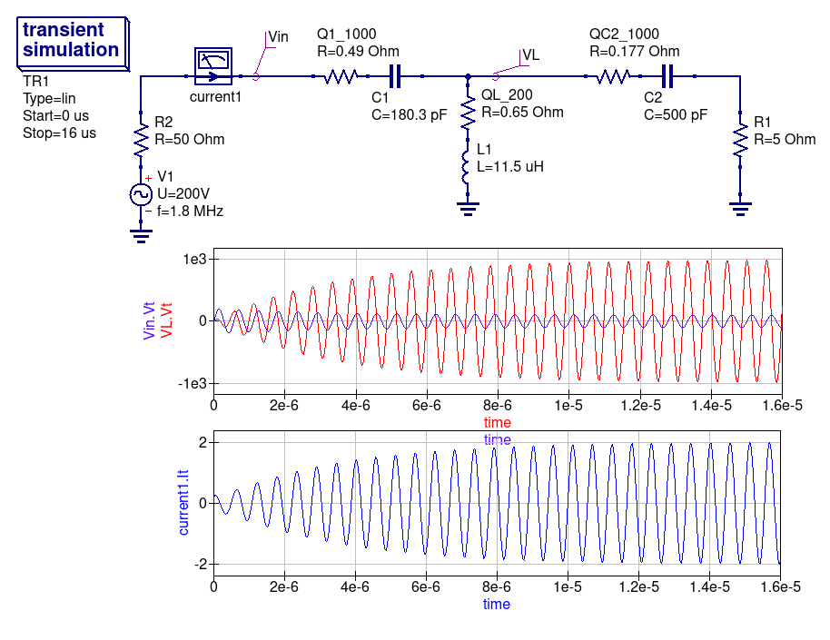
Match
Input voltage: 100V
But peak voltages across tuner elements are 1000V

Slide 34
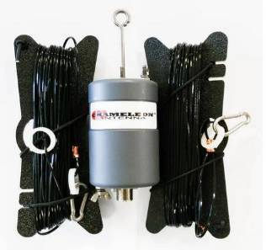
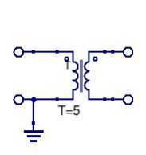
High RF Tuner Voltages
High Voltage in tuner elements
  100 volts peak source
  1000 volts peak across components
Arcing and RF burns potential
Solutions include better antenna design
  e.g., a Balun can help match
Example: 5:1 transformer
Matches 50 ohm coax
To 300 ohm antenna
50
300

Slide 35


Questions?
You may email questions later to
phil.brunner@gmail.com
<number>

Slide 36
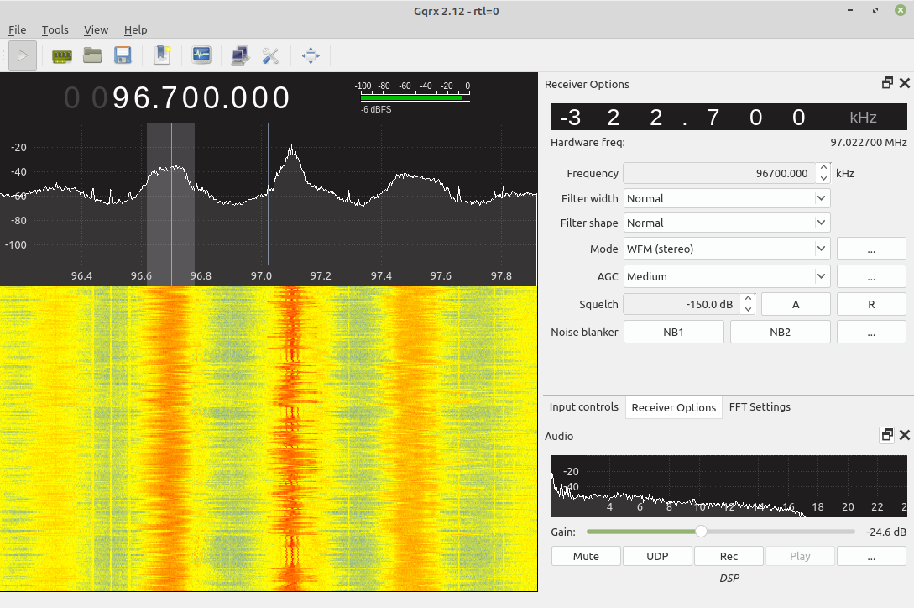
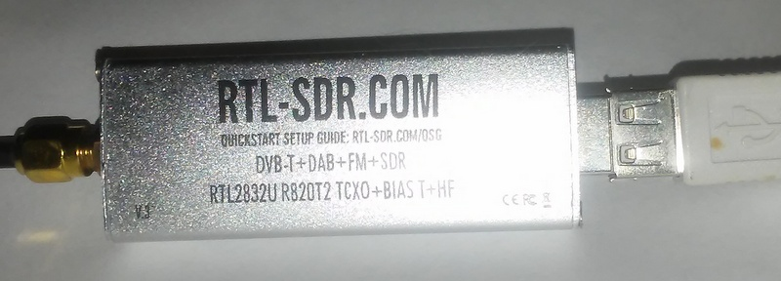
SDR -
Software
Defined
Radio
GQRX (Linux, etc.) https://gqrx.dk/download
SDR# (Windows) https://airspy.com/download/

